Slide 1
BNY
Corporate Action Intelligence – Demo
Corporate Action Intelligence Team
Aesha Gandhi, Pranshul Bhatnagar, Alex Li, Kedar Vaidya, Aaron Jiang

Slide 2
CORPORATE ACTION INTELLIGENCE
Problem Statement & Solution Architecture
Large & Complex Documents
Relevant information is spread across lengthy filings, footnotes, and supporting exhibits.
Terms Change Over Time
Amendments dynamically revise transaction prices, key dates, and execution conditions.
Values Need Context
Key numerical values must be linked to the correct event, field, and verified source.
Covered Event Types: Mergers • Tender Offers • Exchange Offers • Rights Issues • Conversions
GOAL: Build a structured corporate-action dataset with traceable evidence for review and downstream automated processing.
input 01
Intake & Classification
timeline 02
Temporal Event Tracking
settings 03
Downstream Processing
verified_user 04
Audit & Exceptions

Slide 3
DATA PREPROCESSING & REASONING ARCHITECTURE
End-to-End Event Pipeline
01
02
03
04
SEC Metadata
Retrieve Filing Bundle
Normalize Documents
Extract Candidate Facts
Initial discovery and indexing via SEC EDGAR
Fetch complete source documents and exhibits from SEC EDGAR.
Convert raw HTML into clean, searchable plain text.
AI layer (GliNER) extracts structured candidate fact payloads.
05
06
07
08
Concise Representation
Reason / Verify / Resolve
Canonical Event State
BNY Client Notification
Compact event representation preserving evidence & context.
Process amendments and resolve canonical facts.
Single source of truth for verified corporate action facts.
Enriched internal context integrated for downstream alerts.

Slide 4
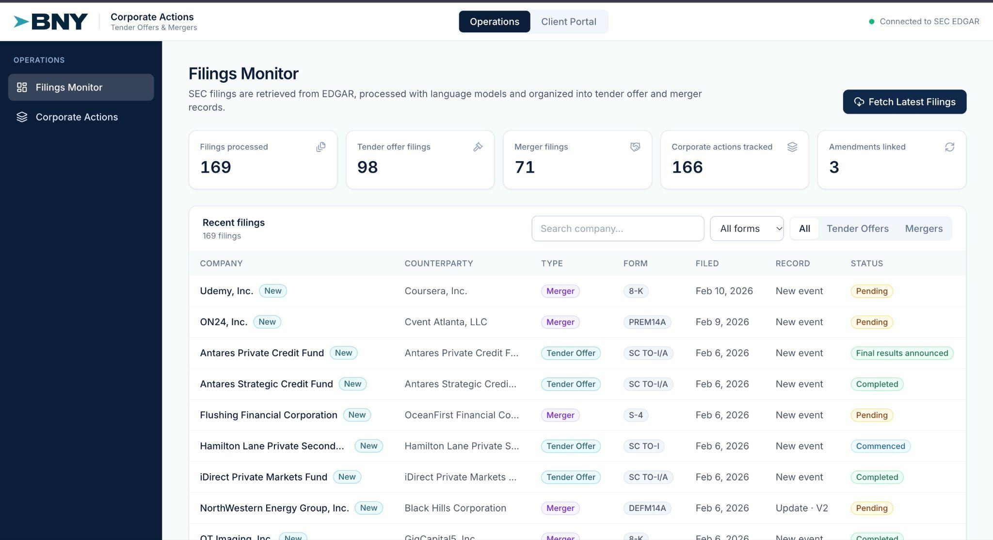
CORPORATE ACTION INTELLIGENCE
Filings Monitor Demo

Slide 5

EVALUATION FRAMEWORK
Ground Truth Creation for Evaluation
GOAL: Create a consistent benchmark for evaluating our extraction pipeline.
Approach
01
Collect Filings
Collect historical SEC filings.
02
Standardize Prompt
Use one standardized schema + prompt across all filings.
03
LLM Generation
Run each filing through an LLM to generate structured reference outputs.
04
Normalize & Retain
Normalize field formats and retain source passages.
05
Manual Review
Review ambiguous cases.
Why
Scalable Methodology
Scales efficiently without relying entirely on fully manual labeling efforts, accelerating dataset creation while preserving quality.
Comprehensive Evaluation
Enables rigorous and consistent benchmarking of extraction accuracy, completeness, source grounding, and amendment handling.

Slide 6
EVALUATION METHODOLOGY
Validation & Observability Framework
Human–Like Verification Approach
Evaluates extracted corporate action fields by leveraging LLMs to inspect the source document retrospectively, mimicking human domain audit rigor.
Mimics Expert Verification
Contextual Grounding Check
Replicates how domain experts verify structured facts against raw source text.
Confirms extracted values are explicitly supported by filing context.
Stream 1 · Baseline Benchmark (Pre-Deployment)
PIPELINE TESTING & ACCURACY BASELINING
STAGE 01
STAGE 02
STAGE 03
LLM GT Extraction
Run Pipeline
Benchmark Accuracy
LLM extracts golden facts from 1,000 reference corporate action filings.
Execute extraction pipeline against the identical 1,000-document set.
Compare pipeline outputs against LLM ground truth to score baseline performance.
Stream 2 · Continuous Observability (Post-Deployment)
CONTINUOUS PRODUCTION SAMPLING
STEP 01
STEP 02
STEP 03
Production Sampling
Backward LLM Search
Grounding & Drift Audit
Continuously sample subsets of live pipeline extractions across active filing streams.
Inspect raw filing text retrospectively to verify extracted facts against the source.
Detect hallucinations, verify grounding scores, and flag live production drift.

Slide 7
EVALUATION METHODOLOGY
LLM Backward Validation
Human-Like Verification Approach
Evaluates extracted corporate action fields by leveraging LLMs to inspect the source document retrospectively.
• Mimics Expert Verification
Replicates how human domain experts verify structured facts directly against raw source text.
• Contextual Grounding Check
Checks whether extracted values are explicitly supported by the underlying filing context.
Validation Workflow Mechanism
Validates accuracy across key corporate action fields (e.g., offer price, expiration date, tender terms) directly against normalized filing text.
Extracted Field ➔ LLM Backward Search ➔ Ground Verification

Slide 8
Questions & Discussion Points
01
What downstream tasks are of interest to the BNY team or prioritized?
02
Which steps take the most time or require the most manual work?
03
What evidence would your team need to trust and use an extracted result?
04
Which extraction errors would have the greatest business impact?
05
Are there any gaps in our presented workflow and demo; what tasks or information can we address?

Slide 9

Questions?
We'd love to hear your feedback and answer any questions.
Thank you for your time and continued support with the BNY Corporate Actions Intelligence initiative.
Corporate Action Intelligence Team
Aesha Gandhi, Pranshul Bhatnagar, Alex Li, Kedar Vaidya, Aaron Jiang

Slide 10
Appendix

Slide 11

Structure-First Extraction Pipeline
Deterministic section routing and targeted local extraction using GLiNER and Regex
STEP 1
CLASSIFY
STEP 2
ROUTE
STEP 3
BOUND
STEP 4
EXTRACT
STEP 5
RECONCILE
1. Document Role
Tag file as cover, otp, sc_14d9, or amendment.
2. Structure Routing
Deterministically find candidate sections instead of full-doc search
3. Local Window
Isolate bounding spans around identified target headings
4. GLiNER / Regex Extraction
Targeted entity extraction on bounded spans
5. Source-Aware Reconciliation
Resolve field conflicts across the package
“Structure finds where to look. GLiNER finds the value.”

